Slide 1
World Development Measurement Analysis
Clustering Models and Insights

Slide 2
Team Details
Ms. Isha Mangesh Chavan
Mr. S Harshavardhan reddy
Dintakurthi Sai Srujan Narayana
Vombravalli Shankar
Relangi Hemanth Kumar
Ms Mangaladevi Udupudi
C Vinod Kumar Reddy

Slide 3
Agenda
Introduction
Dataset Overview
Data Preprocessing
Exploratory Data Analysis
Model Building
Model Deployment

Slide 4

Introduction
World development measurement serves as a crucial lens through which we examine the multifaceted progress and challenges faced by nations across the globe. By meticulously analyzing a diverse array of indicators spanning economic, environmental, and social dimensions, we aim to uncover patterns and insights that underpin the complex landscape of global development. This project employs advanced clustering models to categorize countries based on key metrics, providing a nuanced understanding of the unique trajectories each nation follows on its developmental journey. In doing so, we aspire to contribute valuable insights that empower decision-makers and stakeholders to navigate the intricate dynamics of our interconnected world more effectively.

Slide 5
Introduction
The project focuses on uncovering global development patterns through advanced clustering models
The primary objective is to gain insights into the diverse development patterns exhibited by countries worldwide
To achieve this goal this project utilizes a comprehensive dataset encompassing crucial metrics like Birth Rate, CO2 Emissions, GDP, and more.

Slide 6
Dataset Overview
The dataset contains a comprehensive collection of 2704 records and 25 features, offering a detailed snapshot of global development.
It contains diverse data types including float64, object and int64, presenting initial challenges in ensuring uniformity for analysis.
Many features exhibit varying degrees of uniqueness, emphasizing the diversity in global metrics.
Initial challenges include handling missing values, converting data types, and identifying irrelevant columns for streamlined analysis.

Slide 7
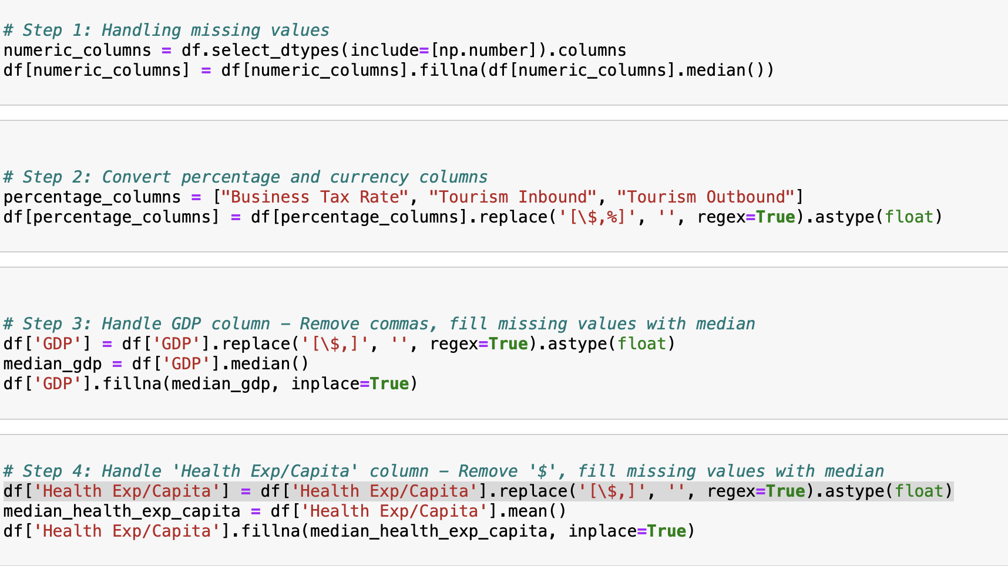
Data Cleaning and Preprocessing
Data Type Conversion and handling null values:
Converting object-type features to appropriate numeric format is very essential for handling null values
The original dataset has many features which are of object data-type like GDP, Health Exp/Capita, Business Tax Rate, Tourism Inbound, Tourism Outbound containing currency symbols and commas which need to be removed for appropriate conversion to numeric types.
After converting them into numeric types the missing values are filled with median value of each column

Slide 8
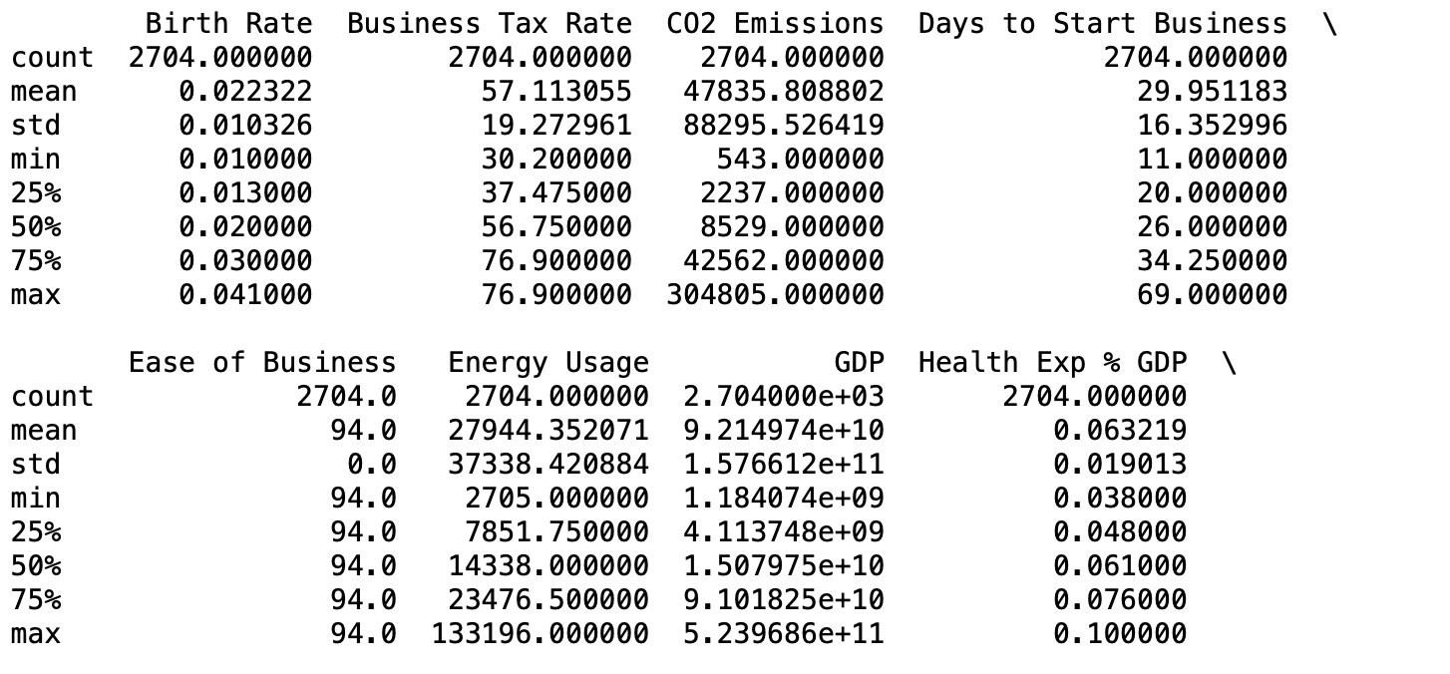
Exploratory Data Analysis
Descriptive Statistics:
It includes initial statistical summaries, including mean, median, and quartiles providing an overview of feature distributions
The descriptive statistics reveal substantial economic disparities among the countries in the dataset. For instance, the "GDP" feature shows a wide range, with a mean of 9.21e+10 and a standard deviation of 1.58e+11, indicating significant variations in economic output. This suggests diverse economic conditions, with some countries having considerably higher GDPs than others.
Examining the "Days to Start Business" feature provides insights into the variations in the business environment across countries. The mean value of approximately 29.95 days, with a standard deviation of 16.35, showcases the diversity in bureaucratic processes related to starting a business. Some countries may have streamlined procedures with quicker turnaround times, while others face more bureaucratic challenges and delays in business initiation

Slide 9
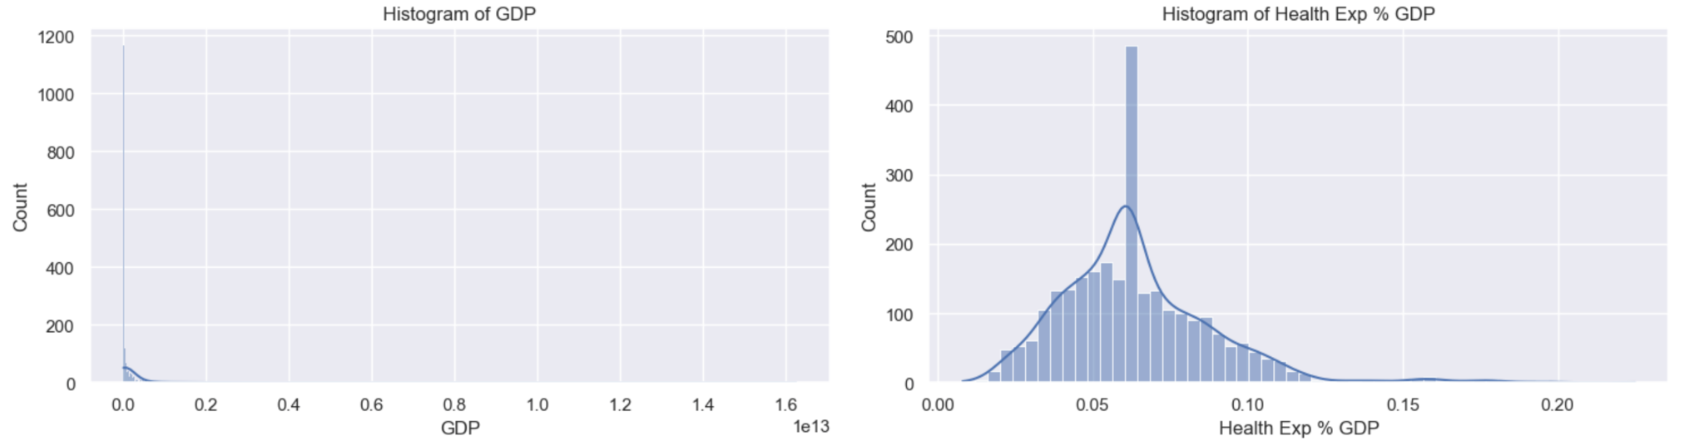
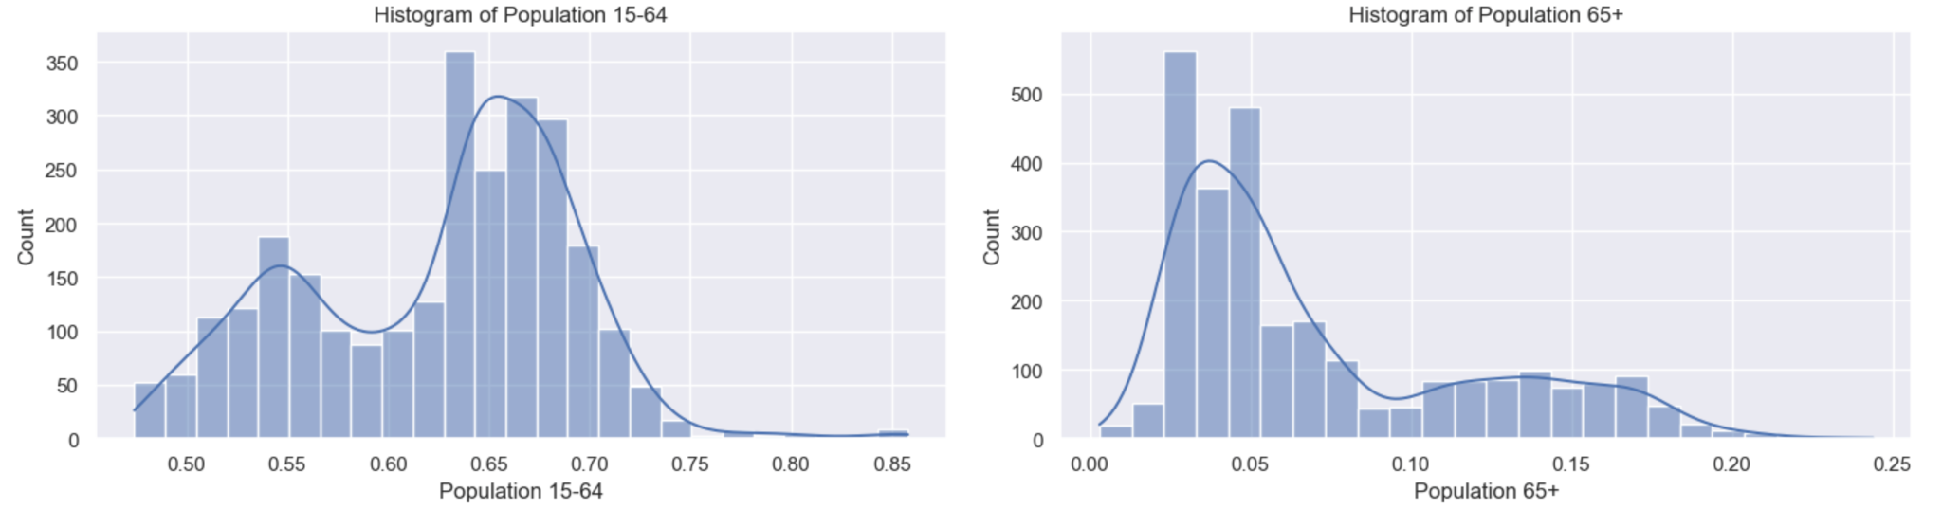
Exploratory Data Analysis
Univariate Analysis:
It helps in exploring individual feature characteristics, such as Business Tax Rate and CO2 Emissions, to identify potential outliers and patterns.
Univariate analysis of population-related features, such as "Population 0-14," "Population 15-64," and "Population 65+," provides valuable insights into age demographics across countries. The distribution of these age groups can offer clues about the population structure, indicating whether a country has a relatively younger or older population.
Utilizing univariate analysis on the "GDP" feature allows us to explore the distribution of economic output among the countries. Examining measures like mean, median, and standard deviation provides insights into the overall economic landscape and the degree of economic disparity across the dataset.

Slide 10
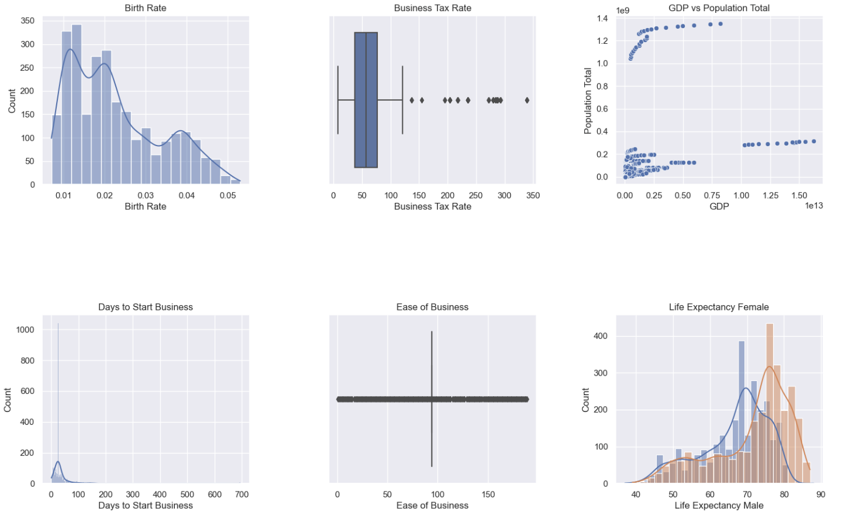
Exploratory Data Analysis
Histograms and Boxplots:
Birth Rate Distribution:
The histogram of "Birth Rate" (Plot 1) provides an overview of the distribution of birth rates across countries. Peaks and patterns in the histogram can indicate regions with high or low birth rates, contributing to demographic analysis.
Variability in Business Tax Rates:
The boxplot of "Business Tax Rate" (Plot 2) displays the spread and central tendency of business tax rates. Outliers or clusters in the boxplot may highlight countries with distinctive taxation policies, offering insights into economic structures.
GDP and Population Relationship:
The scatter plot "GDP vs Population Total" (Plot 3) illustrates the relationship between a country's Gross Domestic Product (GDP) and its total population. Patterns in the scatter plot can indicate whether larger populations correlate with higher or lower GDP.
Days to Start Business Distribution:
The histogram of "Days to Start Business" (Plot 4) visualizes the distribution of the number of days required to start a business in different countries. This information is valuable for understanding the ease or difficulty of starting a business globally.
Ease of Business Index:
The boxplot of "Ease of Business" (Plot 5) provides insights into the distribution of the Ease of Doing Business Index. Variability and outliers can signify countries with more or less favorable business environments.

Slide 11
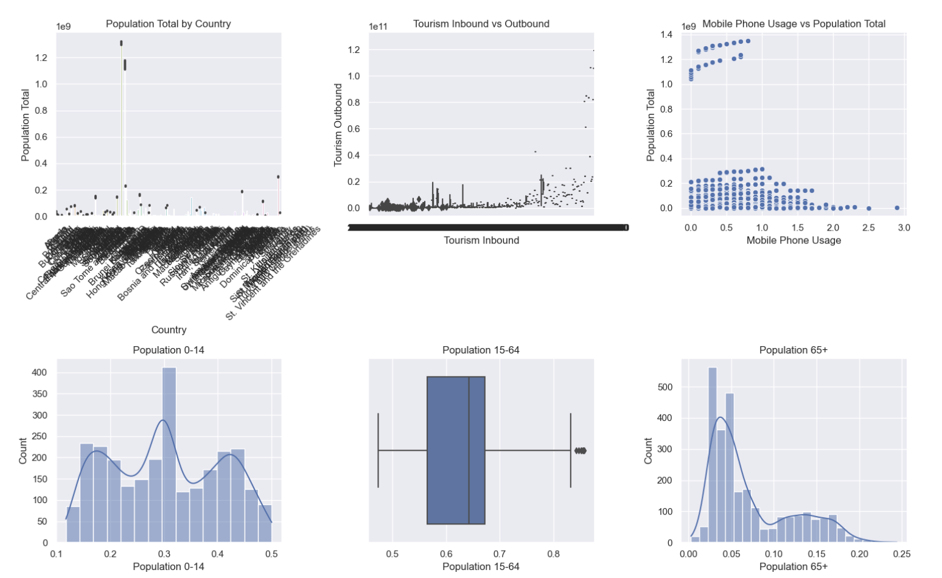
Exploratory Data Analysis
Histograms and Boxplots:
Life Expectancy by Gender:
The overlaid histograms for "Life Expectancy Male" and "Life Expectancy Female" (Plot 6) give a comparative view of life expectancy. Analyzing the distributions helps understand gender-based disparities in life expectancy.
Population Analysis by Country:
The barplot "Population Total by Country" (Plot 7) allows a quick comparison of total populations across different countries. Bar lengths reflect population sizes, aiding in identifying countries with larger or smaller populations.
Tourism Inbound vs Outbound:
The boxplot "Tourism Inbound vs Outbound" (Plot 8) reveals the distribution and relationships between inbound and outbound tourism. This can provide insights into tourism dynamics and economic impacts.
Mobile Phone Usage and Population:
The scatter plot "Mobile Phone Usage vs Population Total" (Plot 9) visualizes the potential correlation between mobile phone usage and total population. Patterns can suggest the level of technological adoption and connectivity in different regions.
Population Age Distribution:
The histogram of "Population 0-14" (Plot 10) illustrates the age distribution in terms of the percentage of the population aged 0-14. Peaks and trends can reveal demographic patterns.

Slide 12
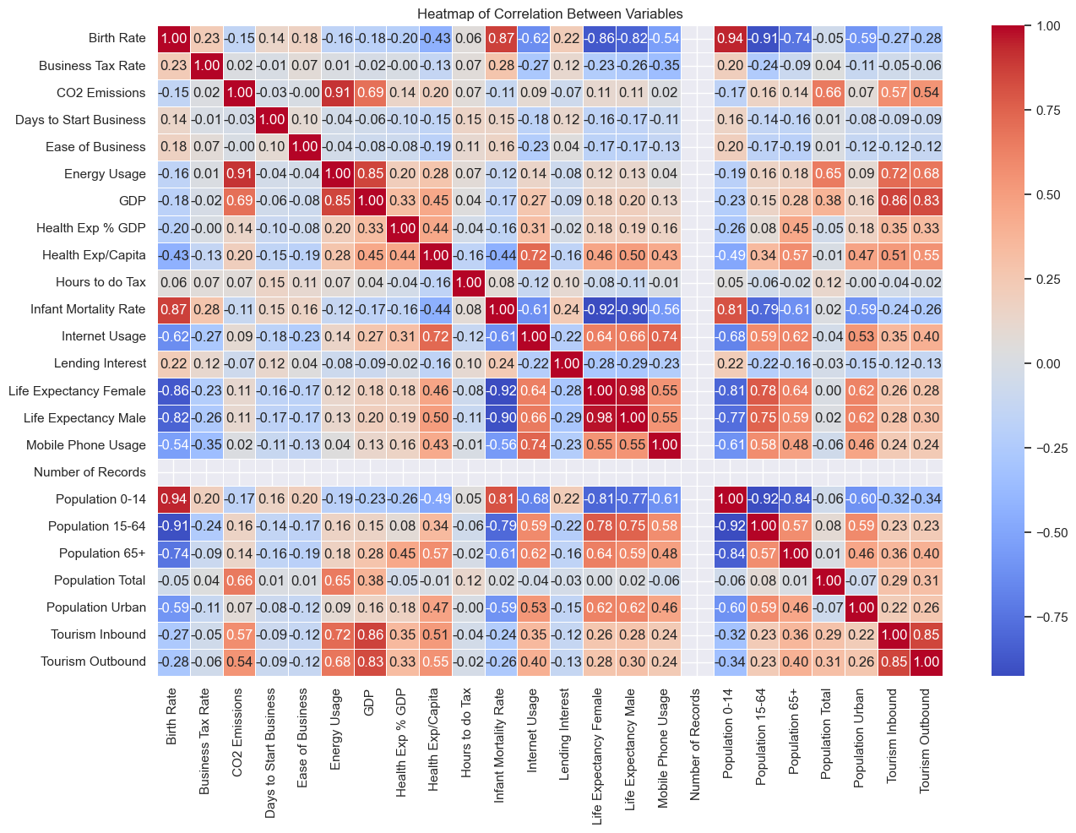
Exploratory Data Analysis
Correlation Heatmap:
Heatmap is a visual representation of the correlation matrix of the dataset
If two features have a deep red color, deep blue color or lighter colors then those features are said to be positively correlated, negatively correlated and not correlated, respectively
There is a high positive correlation between GDP and Health Expenditure which indicate that wealthier countries tend to spend more on healthcare.
Heatmap can help decision-makers to prioritize certain factors. For instance, if there is a strong positive correlation between Education Expenditure and Innovation Index, policymakers might focus on educational investments to foster innovation.

Slide 13
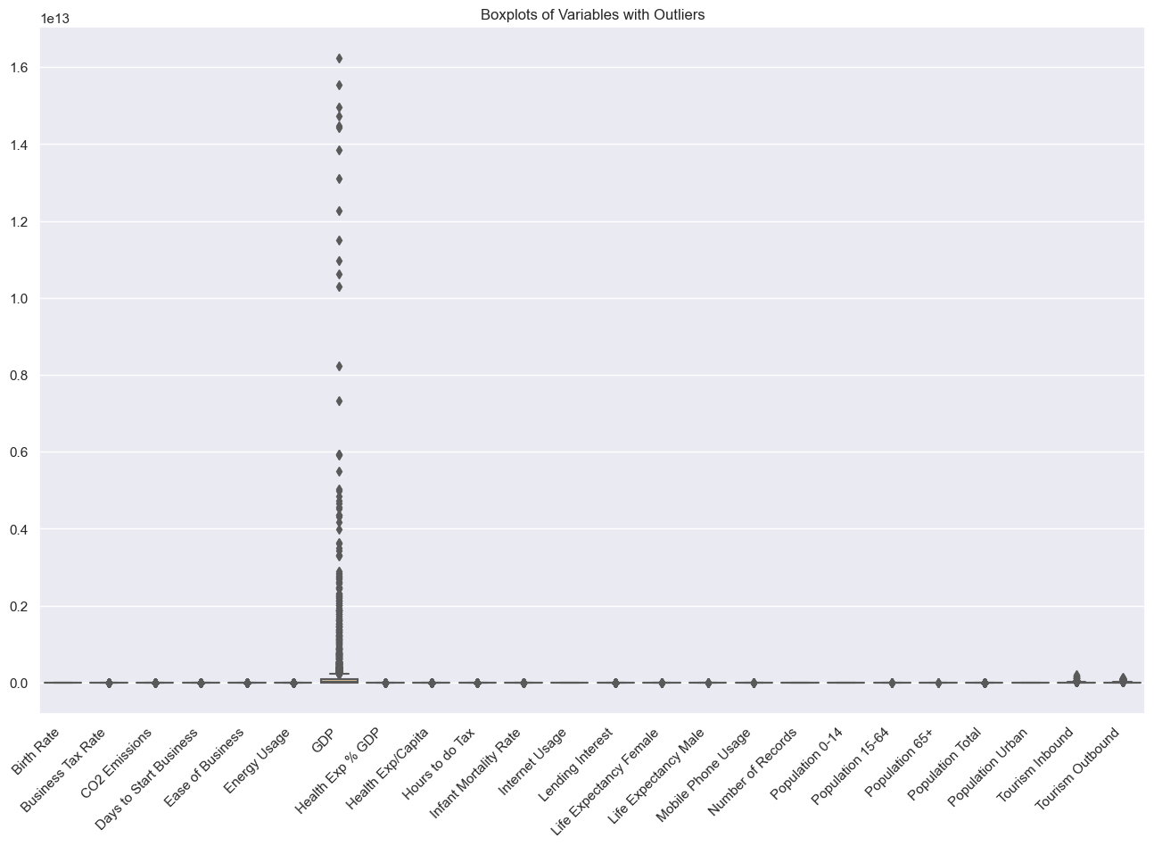
Exploratory Data Analysis
Handling Outliers:
Outliers are data points that significantly differ from the majority of the dataset. Identifying and understanding outliers is crucial in data analysis as they can impact statistical measures and machine learning models.
Utilizing visualizations, such as modified boxplots post-handling outliers, will illustrate the impact on the data distribution.
Here, Winsorizing method is used to handle outliers, which replaces the extreme values with predefined limits.
This preprocessing step makes the data more robust and prevent extreme values from disproportionately affecting statistical analyses or machine learning models.

Slide 14
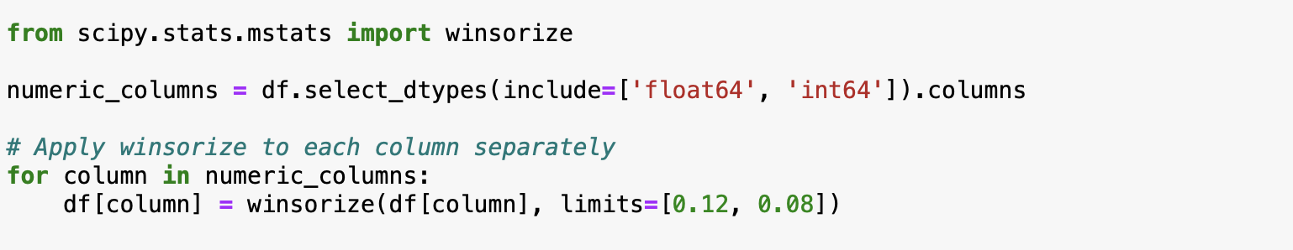
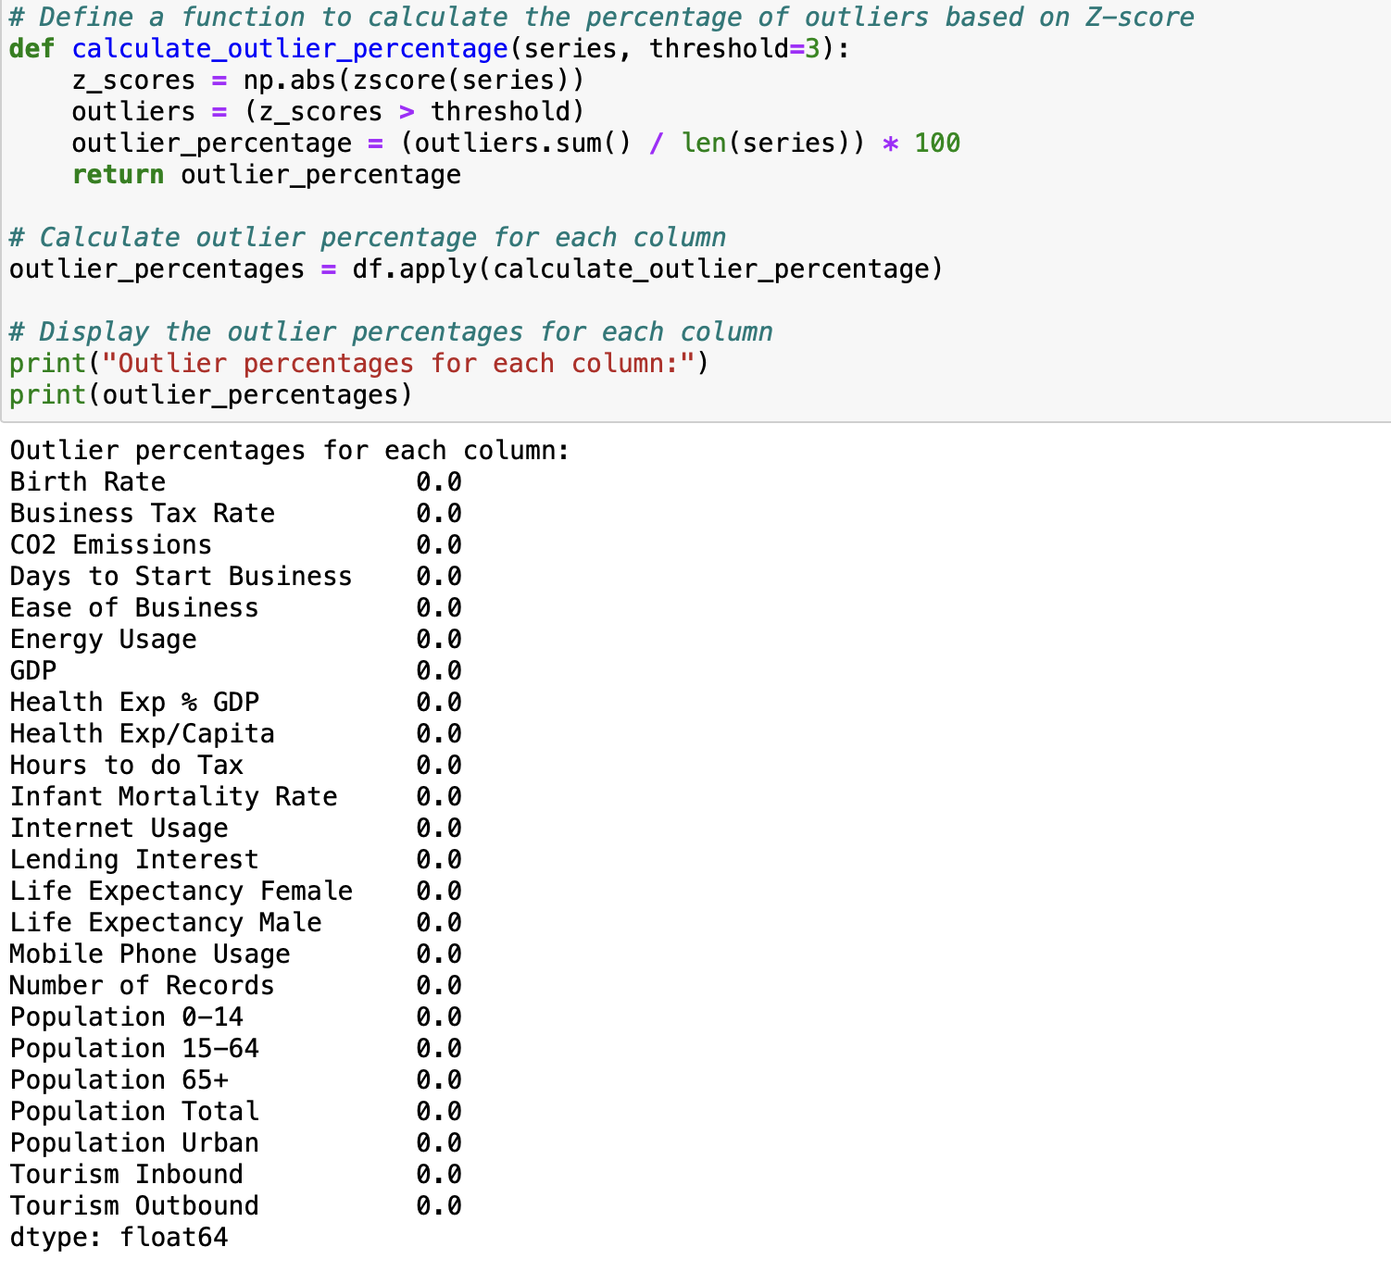
Exploratory Data Analysis
Handling Outliers:
The code for winsorizing method for handling outliers is shown in the image beside
The limits parameter determines the fraction of values to be winsorized on each side. In this case, the lower 12% and upper 8% of the values in each column are replaced with the respective lower and upper limits.
With the help of statistical methods like z-scores, IQR (Interquartile Range), the data points that deviate significantly from the mean can be highlighted.
The image at the bottom right shows the outlier percentages for each column after winsorization.

Slide 15
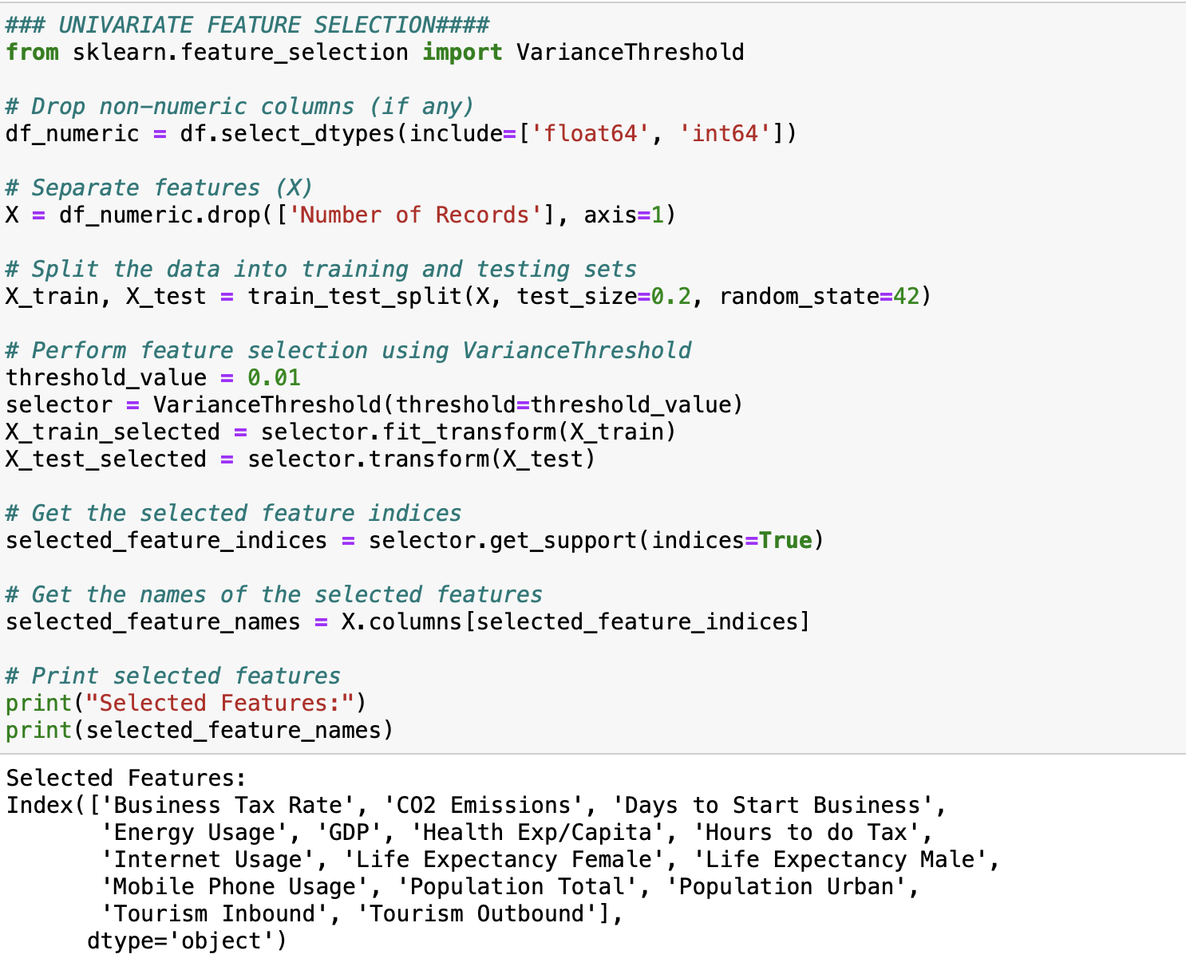
Exploratory Data Analysis
Feature Selection:
Feature selection is a critical step in data preprocessing and analysis that involves choosing a subset of relevant features from the original set of variables. In the image beside, the univariate feature selection method, VarianceThreshold, is employed to identify and retain features with significant variability.
The process begins by extracting numeric columns from the dataset, creating a DataFrame (df_numeric) containing only numerical features. Subsequently, the data is split into training and testing sets using the train_test_split function. The VarianceThreshold is then applied with a specified threshold value (0.01 in this case) to retain only those features with variances above the threshold.
The selected features are printed, providing insight into the features deemed important for the subsequent analysis. Feature selection is crucial for enhancing model performance, reducing dimensionality, and mitigating the impact of irrelevant or redundant features, thereby improving the efficiency and interpretability of machine learning models.

Slide 16
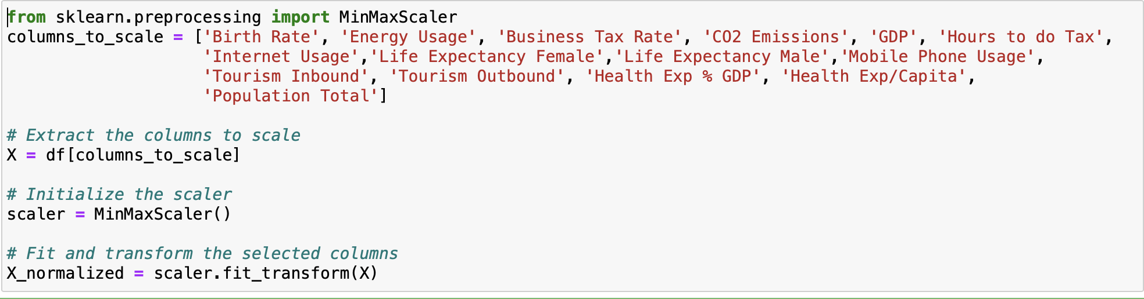
Exploratory Data Analysis
Scaling:
Scaling is a crucial preprocessing step in data analysis and modeling to ensure that all features are on a similar scale. In the image beside, Min-Max scaling is employed using the MinMaxScaler from scikit-learn. This method scales each feature to a specific range, typically between 0 and 1.
The columns_to_scale variable lists the features that will undergo scaling. These features include various metrics such as birth rate, energy usage, business tax rate, and others. The MinMaxScaler is initialized and then applied to transform the selected columns (X), resulting in the X_normalized array, where each feature is now scaled appropriately.
Scaling is essential because it standardizes the range of independent variables, preventing certain features from dominating due to their larger magnitudes. This ensures that each feature contributes proportionally to the analysis or modeling process, leading to more robust and accurate results.

Slide 17
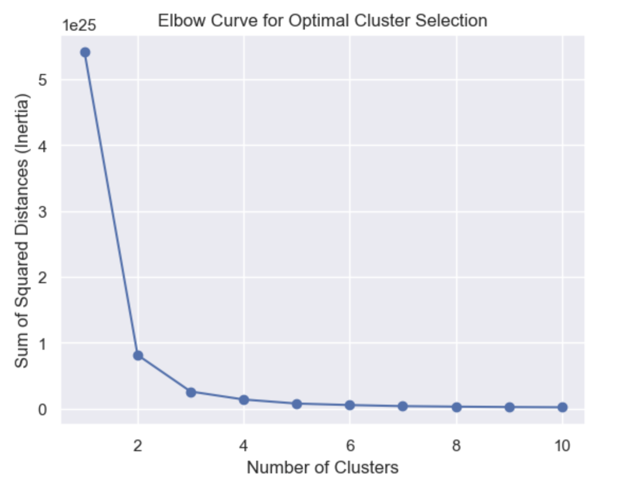
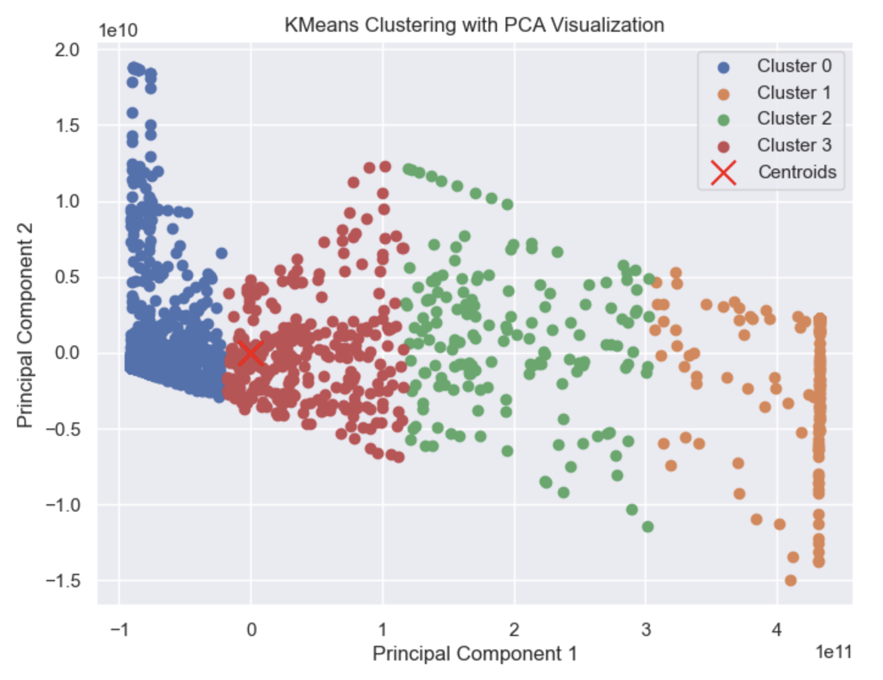
Model Building
K-Means Clustering:
K-Means is a partitioning method that divides a dataset into distinct, non-overlapping subsets (clusters) by minimizing the sum of squared distances between data points and their assigned cluster centroids. It is an iterative algorithm where data points are assigned to the cluster whose centroid is closest, and centroids are recalculated based on the mean of the assigned points.
With the help of wcss, by plotting the elbow curve as shown in the image beside, the optimal number of clusters for the model is 4, and the silhouette score for model with 4 clusters resulted in 0.79.
Although the score is not very high and by taking n_clusters as 2 we get silhouette score up to 84%, but considering the elbow curve number 4 proved to be best choice.
The clusters are visualized using Principal Component Analysis (PCA) for 2D visualization. The scatter plot depicts individual data points belonging to different clusters, identified by distinct colors, while red 'x' markers represent the centroids of each cluster in the K-Means clustering algorithm. This visualization helps in understanding the spatial distribution of data points in a reduced two-dimensional space, facilitating insights into the clustering patterns.

Slide 18
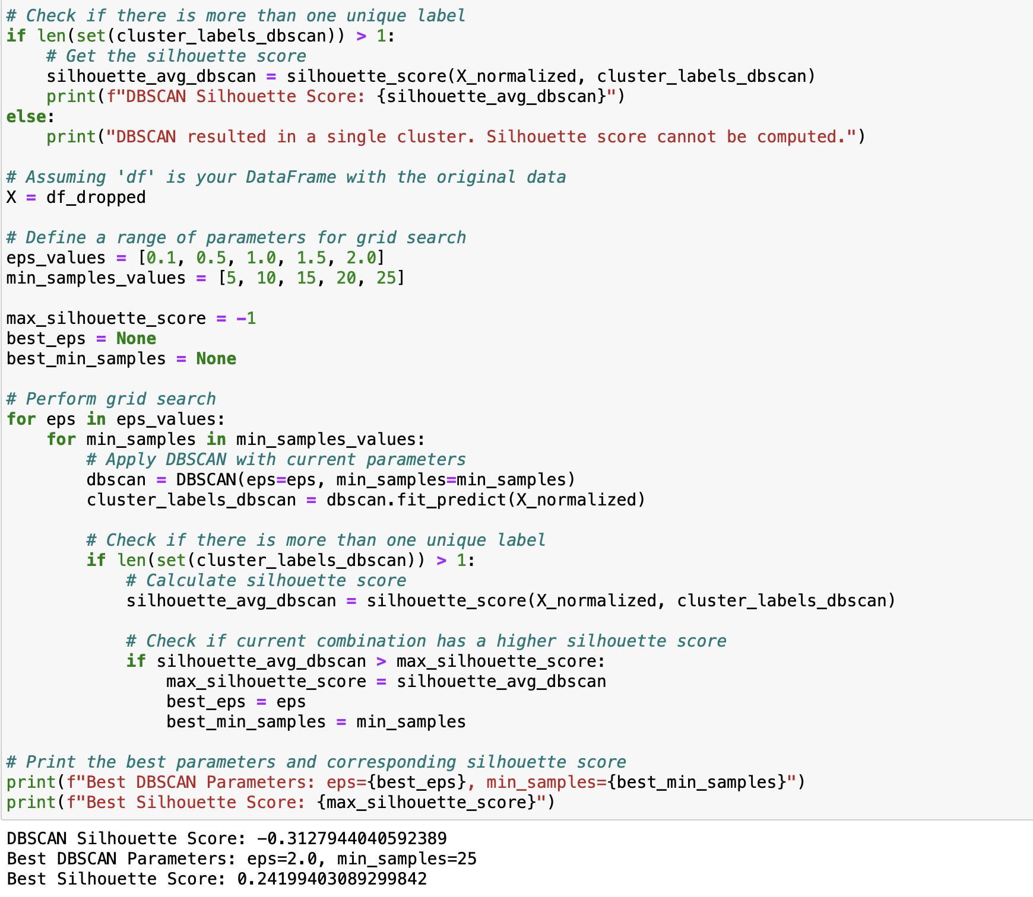
Model Building
DBSCAN:
Unlike K-Means, DBSCAN is a density-based clustering algorithm that defines clusters as dense regions separated by sparser areas.DBSCAN is well-suited for identifying densely populated regions in the world development landscape, capturing nuanced patterns that may not be evident with traditional methods.
The DBSCAN clustering algorithm yielded a suboptimal silhouette score of -0.31, indicating that the clusters are overlapping and poorly defined. Despite conducting a grid search to identify optimal parameters, the selected combination (eps=2.0, min_samples=25) did not result in a more favourable silhouette score. The best silhouette score achieved during the grid search was 0.24, which still falls below the desirable range.

Slide 19
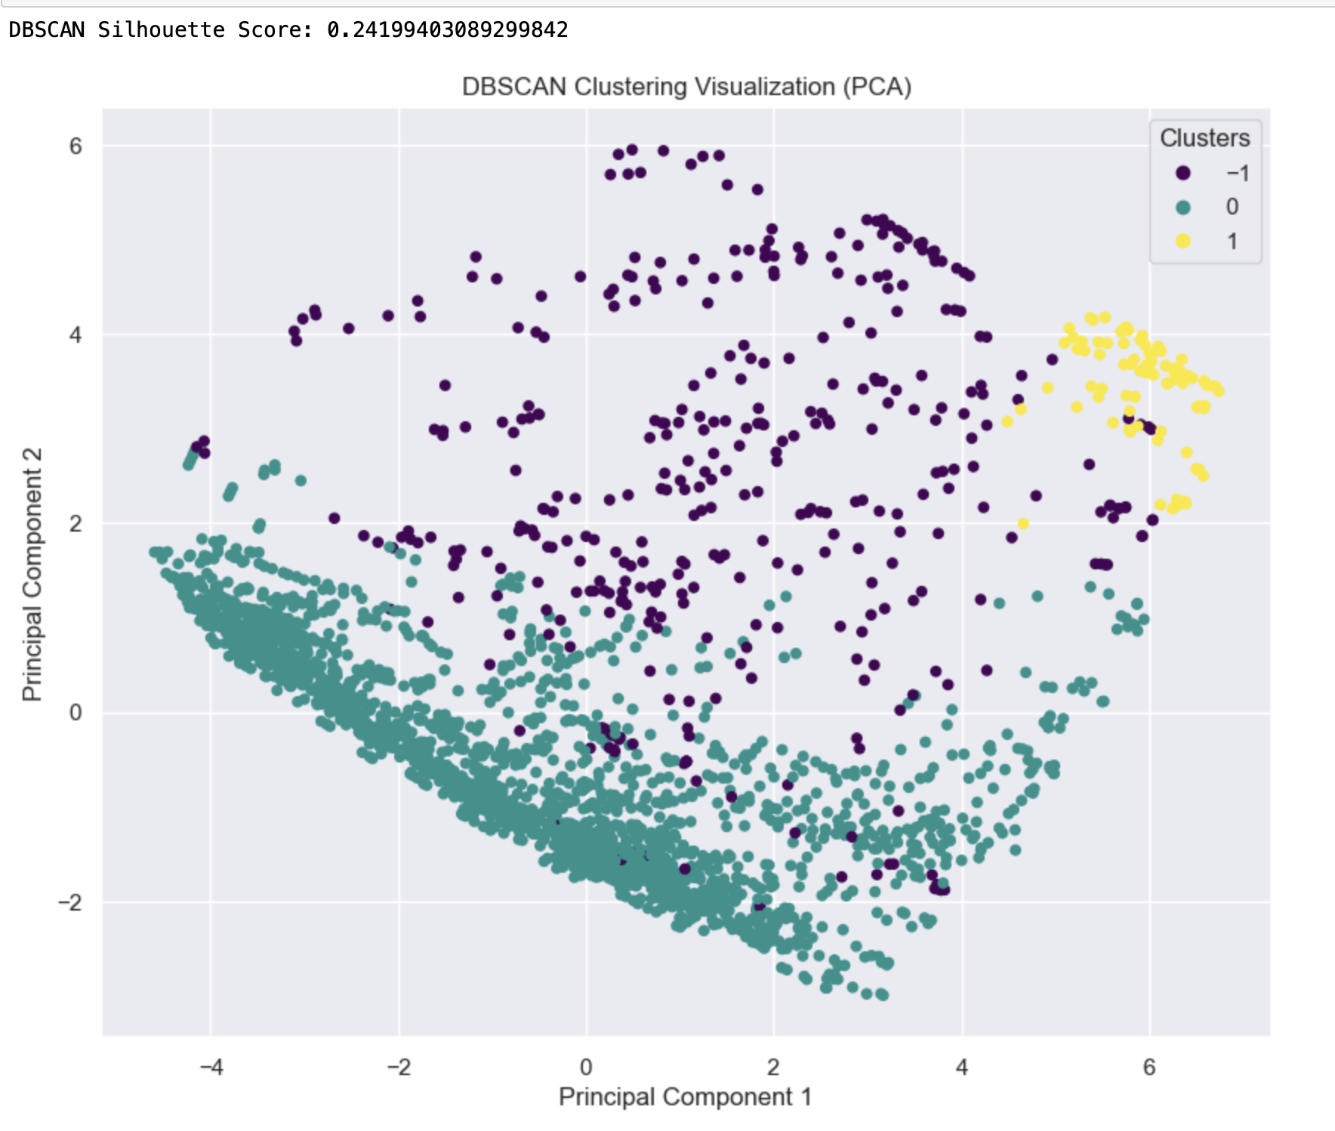
Model Building
DBSCAN:
The visual representation of the clusters using PCA further confirmed the challenges, as significant overlap was observed.
This performance suggests that the algorithm struggled to effectively capture the inherent patterns in the dataset, highlighting the need for a more refined parameter tuning or alternative clustering approaches for improved results.

Slide 20
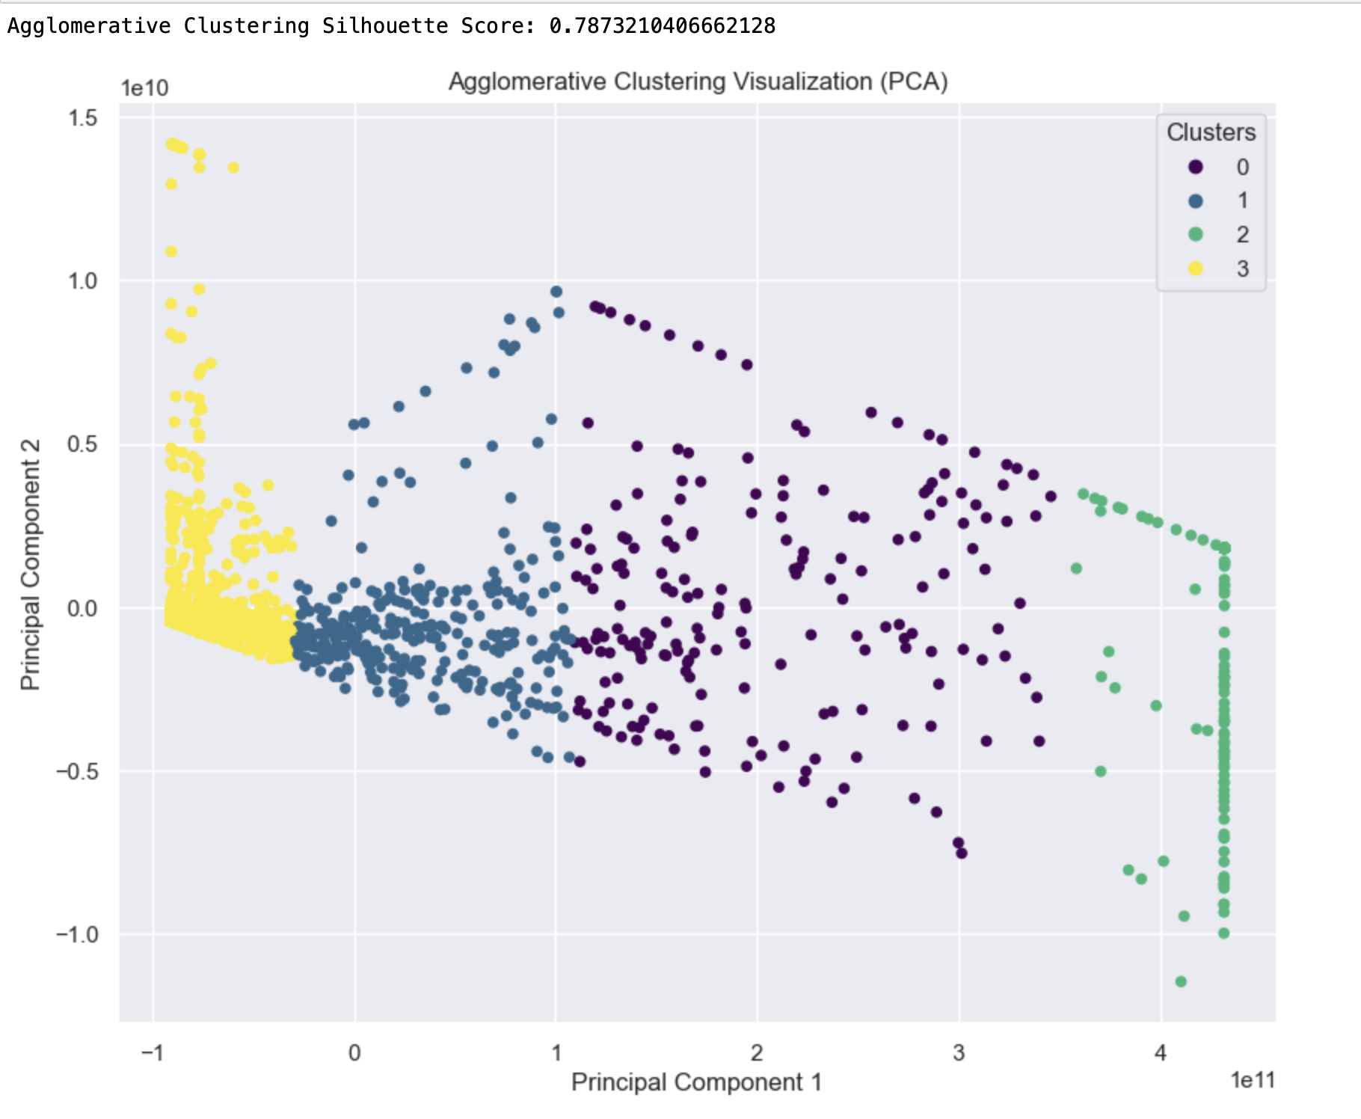
Model Building
Agglomerative Clustering:
Agglomerative Clustering is a hierarchical clustering technique that starts with individual data points and merges them based on similarity, gradually forming clusters. It utilizes a bottom-up approach, iteratively combining the most similar clusters until reaching a specified number of clusters or a predefined linkage threshold.
The Silhouette Score for Agglomerative Clustering is calculated to be approximately 0.79. This metric assesses the cohesion and separation of clusters, with higher scores indicating better-defined and well-separated clusters.
To visually represent the clustered data, Principal Component Analysis (PCA) is employed to reduce the dimensionality to two components. The resulting 2D scatter plot illustrates the distribution of data points among the four clusters, providing insights into the inherent structures captured by Agglomerative Clustering.

Slide 21
Deployment
After model building, the next critical step is the deployment phase.
As we transition from model development to deployment, it's crucial to emphasize that the selected algorithm not only meets the project's requirements but also facilitates seamless integration into the web-based platform.
Given the nature of the World Development Analysis project, K-Means clustering has been chosen for its computational efficiency, interpretability, and ease of implementation. The clear and well-defined clusters produced by K-Means align with the goal of providing insightful and understandable results for stakeholders.
To provide an accessible interface for users to explore the clustered world development data, a Streamlit app is being employed. Streamlit facilitates the creation of interactive and user-friendly web applications, ensuring a seamless and engaging experience for users interacting with the clustering model.

Slide 22
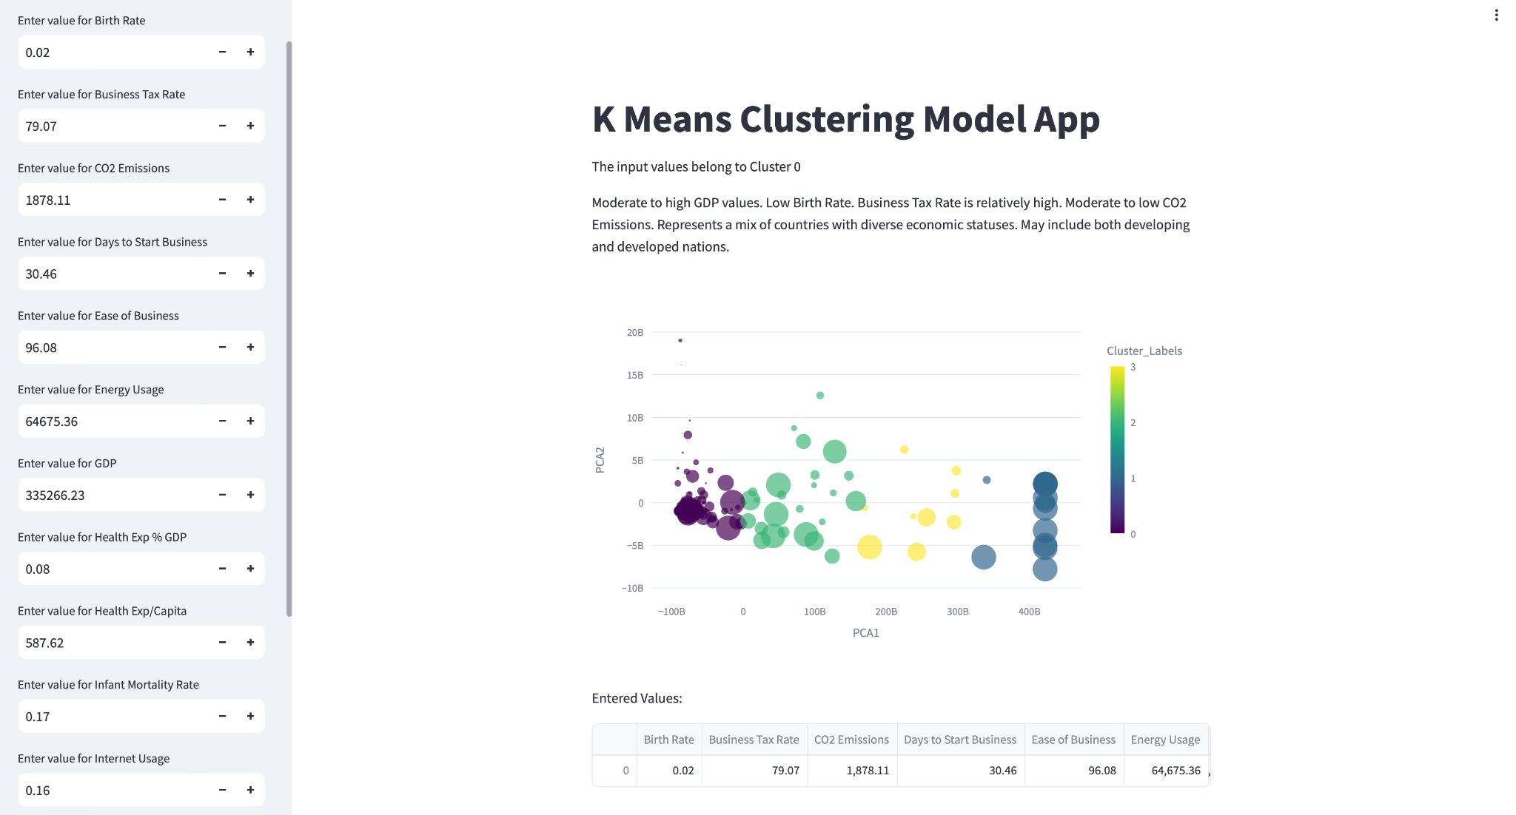
Model Deployment using streamlit

Slide 23
Thank you

